Slide 1

Gender bias – Street names of Porto

Slide 2
Goal
Determining how biased toward men are the street names in the city I live in: Porto, Portugal
Inspired by similar study made for Lisbon’s street names

Slide 3
Data
Street names:
OSM (Open Street Map) obtained using R package osmdata
People:
Data from the Wikipedia
If not found, gender determined using R package that predicts gender based on the name
For dubious cases, manual attribution

Slide 4
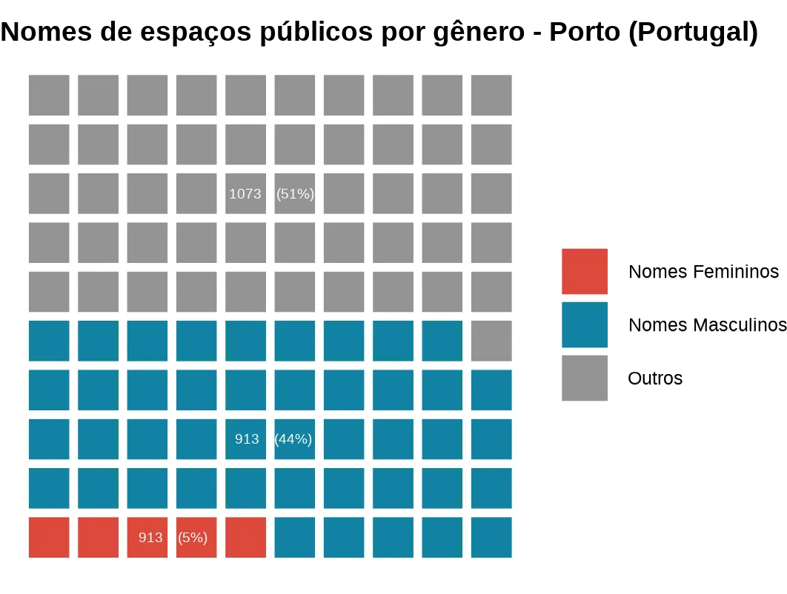
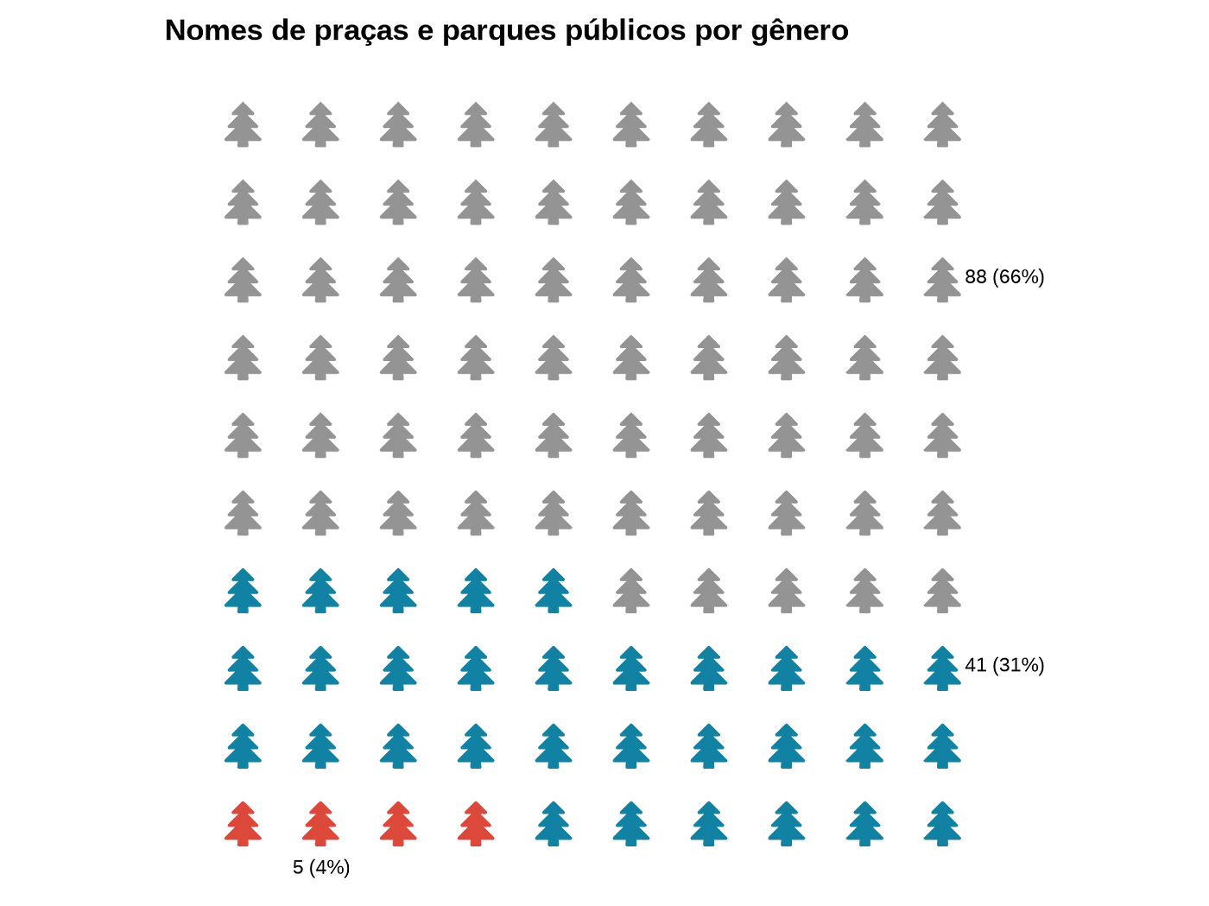
Results

Slide 5
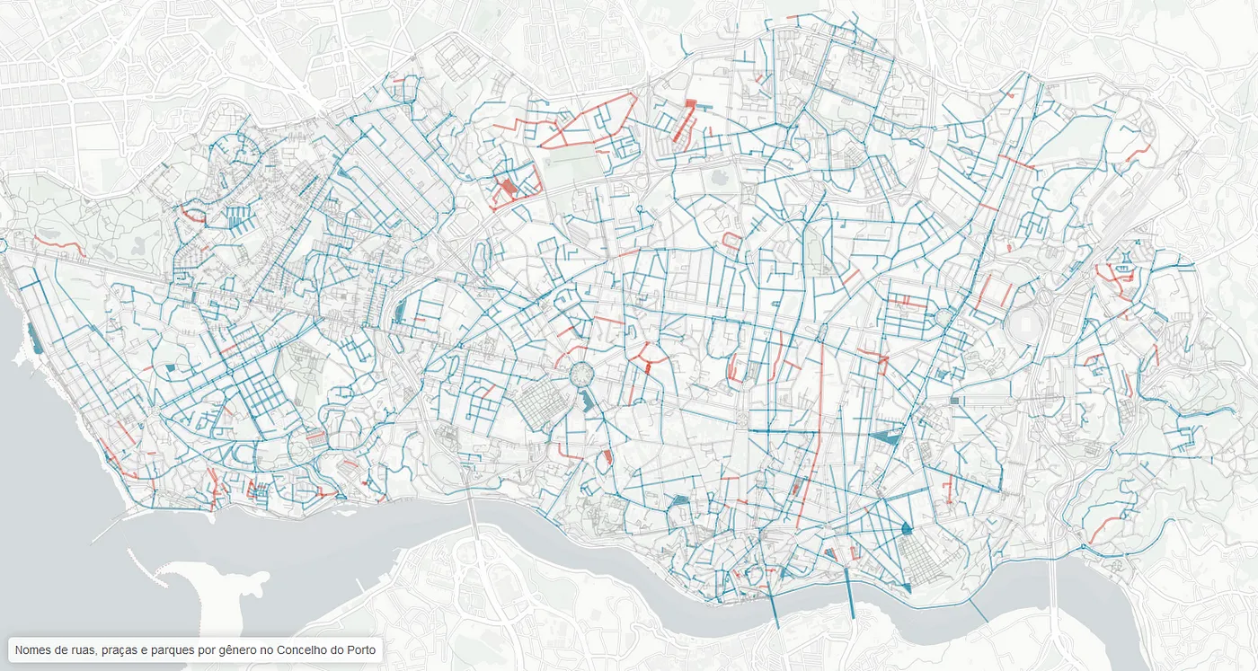

Slide 6
Conclusion
Of all streets named after people, fewer than 10% are named after a woman
No streets named after transgender and non-binary people yet.

